Slide 1
WIT HACKATHON
TechDivas presents:
BiteSavr
By Ella Smith,
Aditi Khedkar,
Bhakthi Salimath
Your smart shopping company

Slide 2
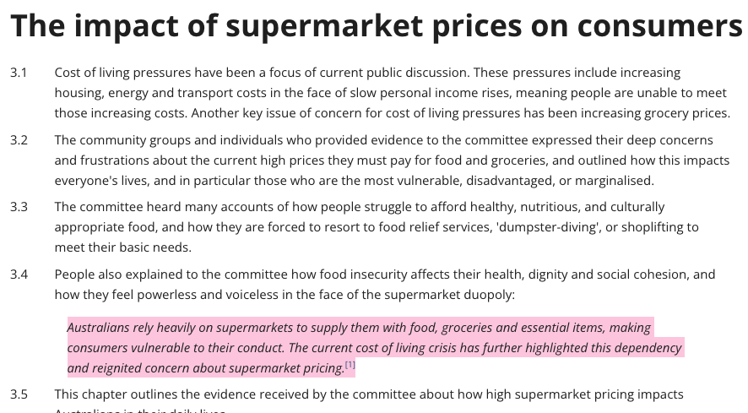

The Problem
Many consumers struggle to find the best prices across multiple grocery stores.
Time-consuming price comparisons
Uncertainty about where to shop for the best deals
Frustration of overspending on groceries
[1] Fair Food WA and WA Council of Social Service, Submission 6, p. 2 .
Notes:
Aditi

Slide 3

Target Audience
Busy families
Students
Budget-conscious shoppers
Intention:
Saves time and money
Simplifies the shopping experience
Offers transparency in pricing
Notes:
Bhakthi

Slide 4
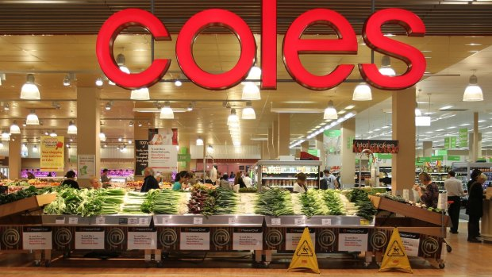
Qualities of Our App
User-Friendly Interface: Intuitive design for easy navigation
Personalized Shopping Lists: Input your list and let BiteSavr do the work.
Price Comparison: Real-time price checking across Coles, Aldi, and Woolworths.
Store Selection: Option to filter results by specific stores.
Notes:
Aditi

Slide 5
Our Solution
How it Works
Users input their shopping list.
BiteSavr retrieves current prices from selected stores.
Provides a list of the cheapest options across different stores or if you only want to shop at 1.
*We’ll walk through a hypothetical scenario of a user finding the best prices for their list*
Notes:
Ella

Slide 6
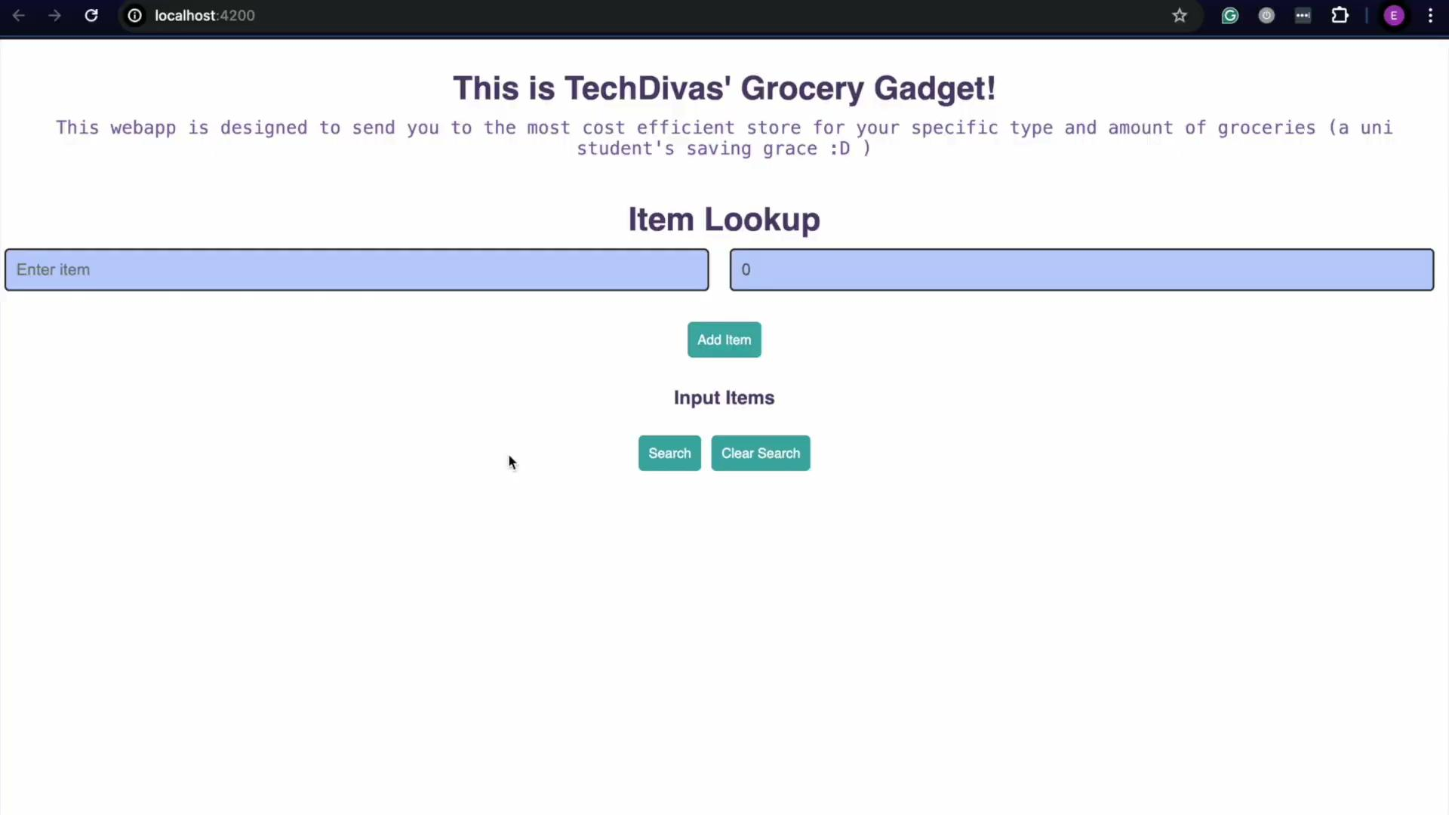
Our Demo

Slide 7

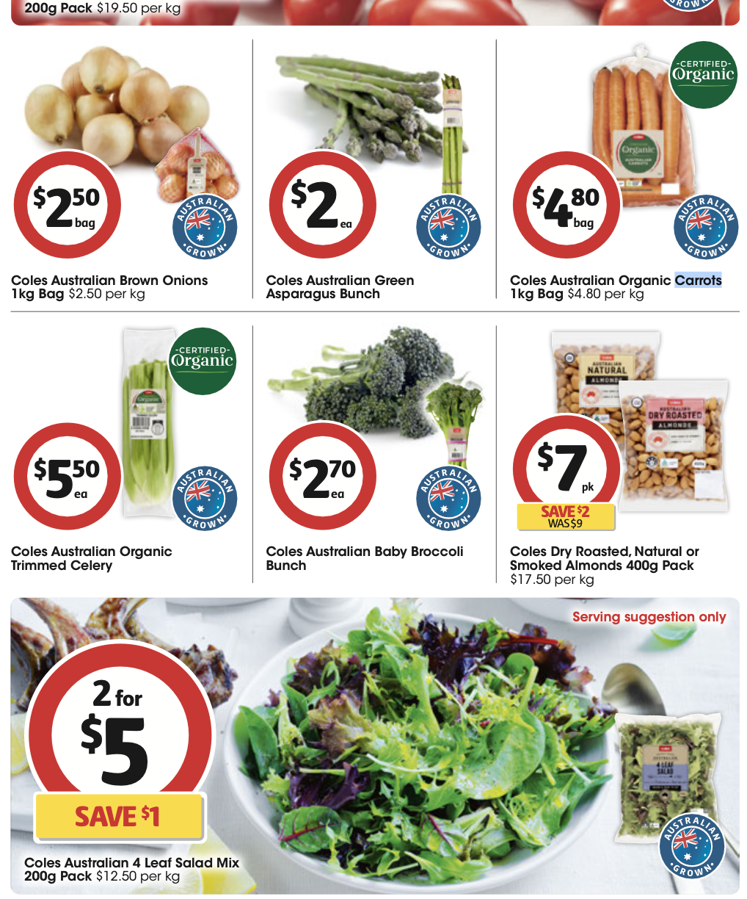

Slide 8
Our Demo

Slide 9
Solution Diagram
Our Wireframe!
This image details the frontend ui and its connection to our backend work
The backend section shows comparing between the databases to find the lowest aggregated cost

Slide 10
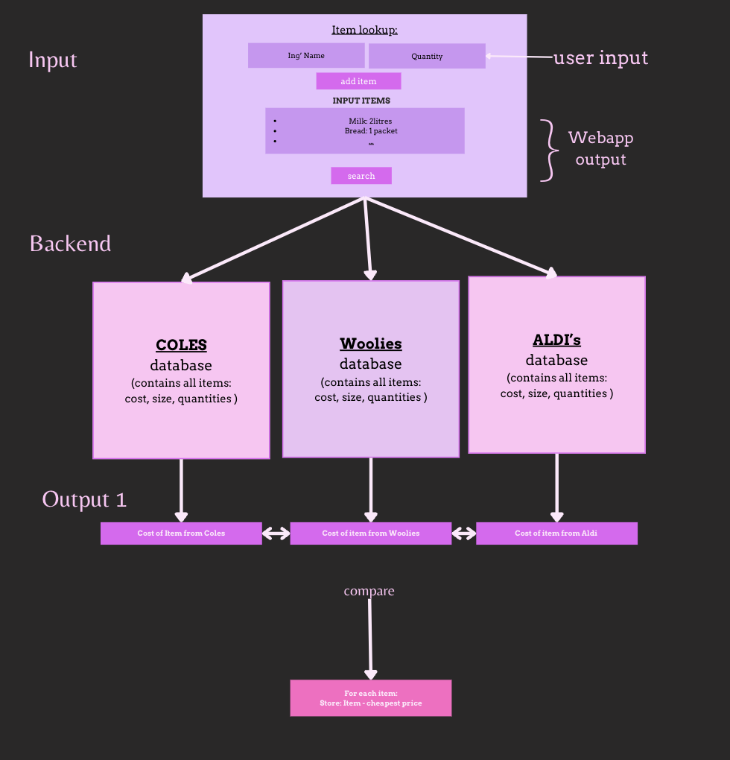

Slide 11
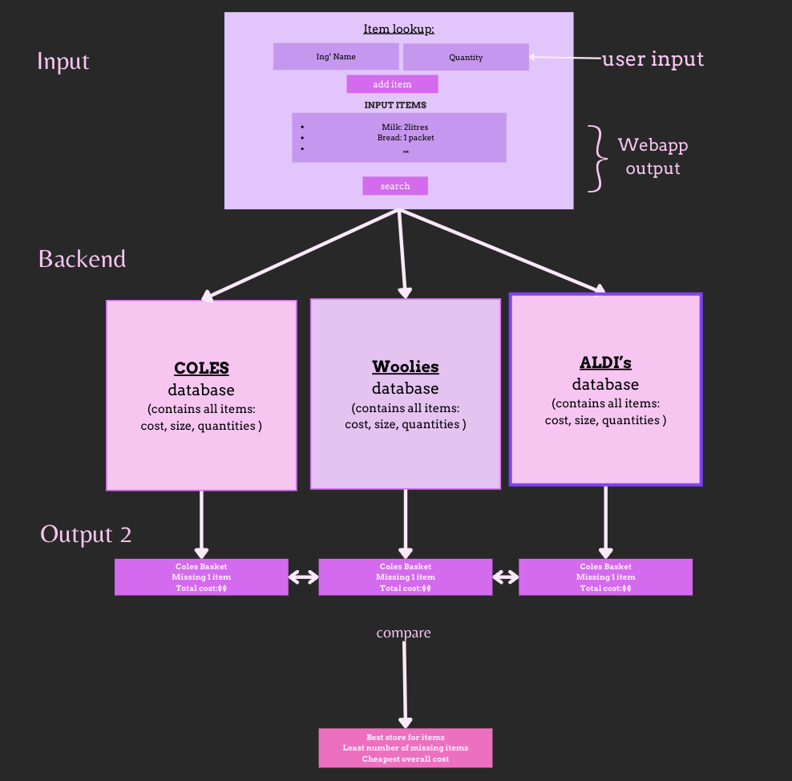

Slide 12
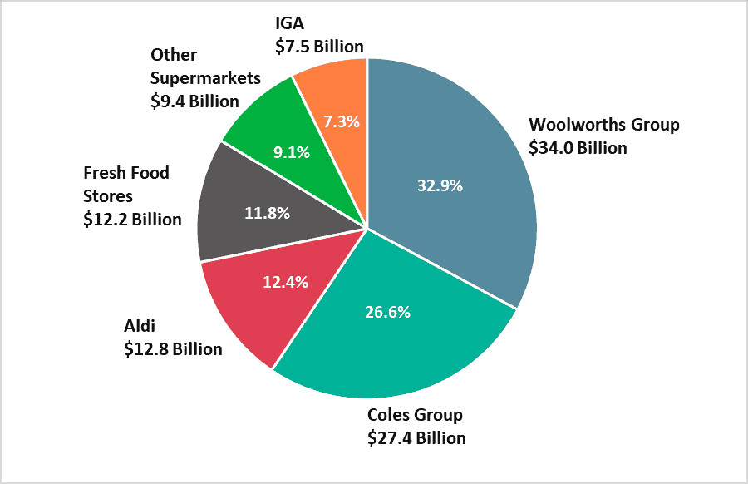
Future implementation
Features:
Expanding to include more stores and online options.
Automatically download PDFs of the stores weekly specials & catalogue.
Adding recipe suggestions based on shopping lists.
Vision:
Become the go-to app for grocery shopping,
helping users save money and time.
[2] (Top 10 Supermarkets in Australia - Shop Smarter, 2022) .
Notes:
Bhakthi

Slide 13
Q & A
BiteSavr
Please feel free to ask us questions about our project!
Notes:
Everyone

Slide 14
BiteSavr
Thank you!
Xoxo,
★ TechDivas ★

Slide 15
References
[1] - Top 10 Supermarkets in Australia - Shop Smarter. (2022, October 5). RedSheep. https://www.trolleymfg.com/supermarkets-in-australia/
[2] - The impact of supermarket prices on consumers. (2020). Aph.gov.au. https://www.aph.gov.au/Parliamentary_Business/Committees/Senate/Supermarket_Prices/SupermarketPrices/Report/Chapter_3_-_The_impact_of_supermarket_prices_on_consumers
Notes:
??

